Slide 1



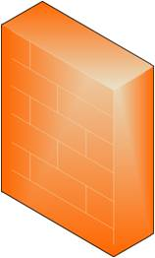


사무공간
192.168.30.0 /24
192.168.40.0 /24
DMZ
Router
DDoS
WAF
방화벽
192.168.20.0 /24
192.168.50.0 /24
웹서버
백업서버
DB서버
192.168.60.0 /24
192.168.70.0 /24

Slide 2
사무공간
192.168.30.0 /24
192.168.40.0 /24
DMZ
Router
DDoS
WAF
방화벽
192.168.20.0 /24
192.168.50.0 /24
웹서버
백업서버
DB서버
192.168.60.0 /24
192.168.70.0 /24

Slide 3
웹서버
DB서버
사무공간
백업서버
DMZ
Router
방화벽
DDoS
WAF
IPS

